Slide 1
BlackFox Game
Studio
Game Development System
By
Russell Powers
MicroGenio Solutions

Slide 2
ToC
Topics
Goals
Security
Blackfox studio Database
The Prime Idea
Design
Technology
Business
MGS Development System
Business Case
business objective
Game Studio Scope & Requirements
13. Game studio
14. Production Plan
15. The Game Plan
16. Project Plan
17. First game wonderland
18. First action
19. First Storyboard
20. First Level
21. First Frame
22. First Actor

Slide 3
Topics
Game Art
Script
Illustration Workflow
Storyboard
Pipeline for asset production
Modeling (maya/blender or Adobe Fuse)
Texture- Photoshop & Illustrator
Game Engine - Unity
Game Design
Mecanim Animation System
Physics
Particle System
Assembling Level
Game Programing
Mapping the terrain of the game environment
Implementing artificial intelligence for non-player characters
Connecting player input via the controller to the events happening onscreen
Graphics programming
Network programming
AI programming
Business
MGS Development System
Business Case
Business Objectives
Game Studio Scope & Requirements
Game Studio Production Plan
First game: Wonderland

Slide 4
Goals
To Fully Develop a system to Use as a Framework for all future Projects.
To Secure the Framework
To Help my Family
To help my Country
To Help the world
To Patient and profit from my Work
Create Templates for each Stage
Create Lab
Create Studio
Create youtube channels covering all Parts
Create Websites
Create Games
Create Phone Apps
Create Social Media Apps

Slide 5
Security
Using the data gathered on iteration 1 of each system build (based of frameworks), I will design a custom build.
Build 1.0 Linux - Pen Test
Security layers
Encrypt each layer
learn Security vulnerabilities and exploits of security applications
Design
Test
implement countermeasures for each Vulnerability and exploit of security application
Network (encrypt)
Firewall (encrypt)
Hard Drive (encrypt)
External Hard Drive (encrypt)
Cloud Storage (encrypt)
Build 1.0 Linux - The (Amnesic) Incognito Live System, a Linux distribution built with security and anonymity in mind.
Security layers
Encrypt each layer
learn Security vulnerabilities and exploits of security applications
Design
Test
implement countermeasures for each Vulnerability and exploit of security application
Build 1.0 Matrix OS linux-
Security layers
Encrypt each layer
learn Security vulnerabilities and exploits of security applications
Design
Test
implement countermeasures for each Vulnerability and exploit of security application
Build 1.0 Windows - Public -
Security layers
Encrypt each layer
learn Security vulnerabilities and exploits of security applications
Design
Test
implement countermeasures for each Vulnerability and exploit of security application

Slide 6
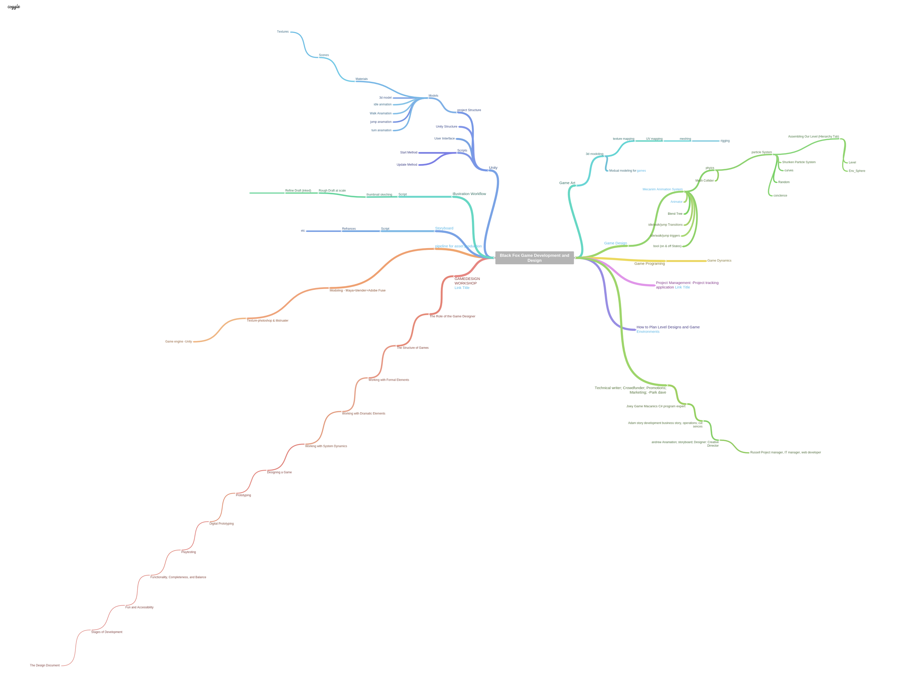
BlackFox Studio Database
Read Me file
Conceptual Mind Map

Slide 7
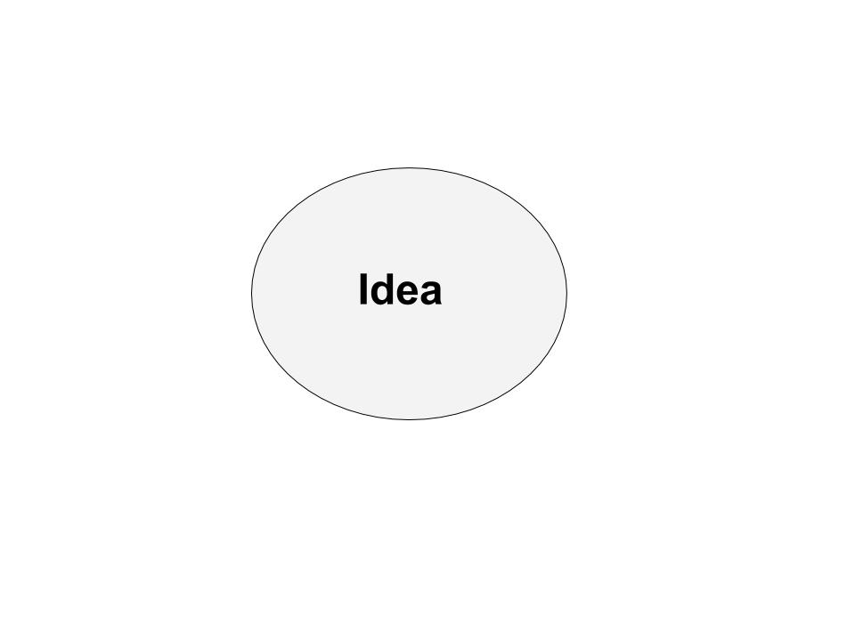
The Prime Idea
What is the Idea?
What are my Goals?
What are the parts of the practice?
Based off my research/ I like?because it's a template that is easy to understand...(Framework)
What are the practical applications?
Are there any mathematical formulas to assist in the practice? (algorithms, Formulas, Functions Geometry, Techniques)
What are the relevant keywords? (Database Keywords)
What are situations i’ve encountered in Regards to Questions i have asked? (test Questions/ Case Studies)
What are ways I can get income from the practice of…? (Business Model)
What resources can i use? (Repository)
How do i store these resources? (Data Modeling)
How many resources do i have that address each part of the practice? (Data Sets, Views, Pivot tables)
How do i organize my list of resources?
What is the most effective outline of a book on the practice?
is my outline efficient? (test outline)
Based on my Test i have decided an effective and efficient guide for the practice is…(Solution Manafest)
Using my guide i have design my own template for practicing…(Study Guide)
The final Solution is a Practical Utility Kit

Slide 8
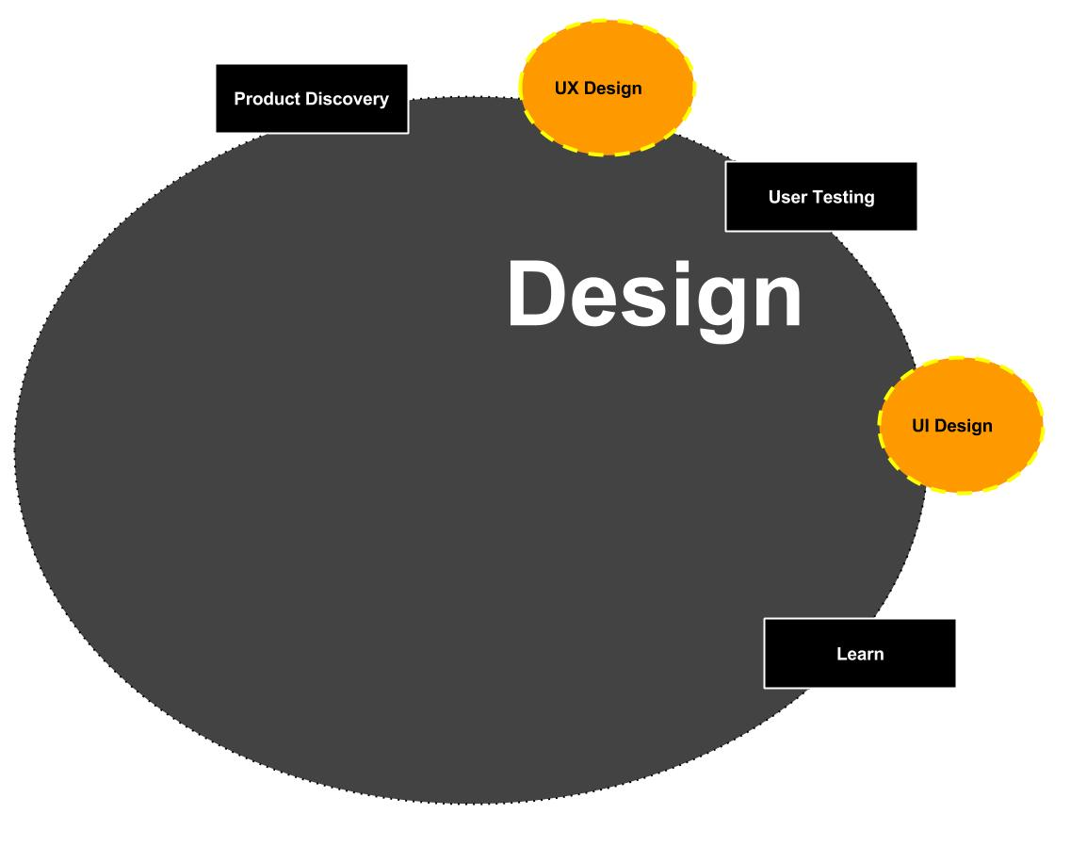
Design
Script
Thumbnail
Rough Draft
Refine Draft
Storyboard
modeling
Texture
Game Engine

Slide 9
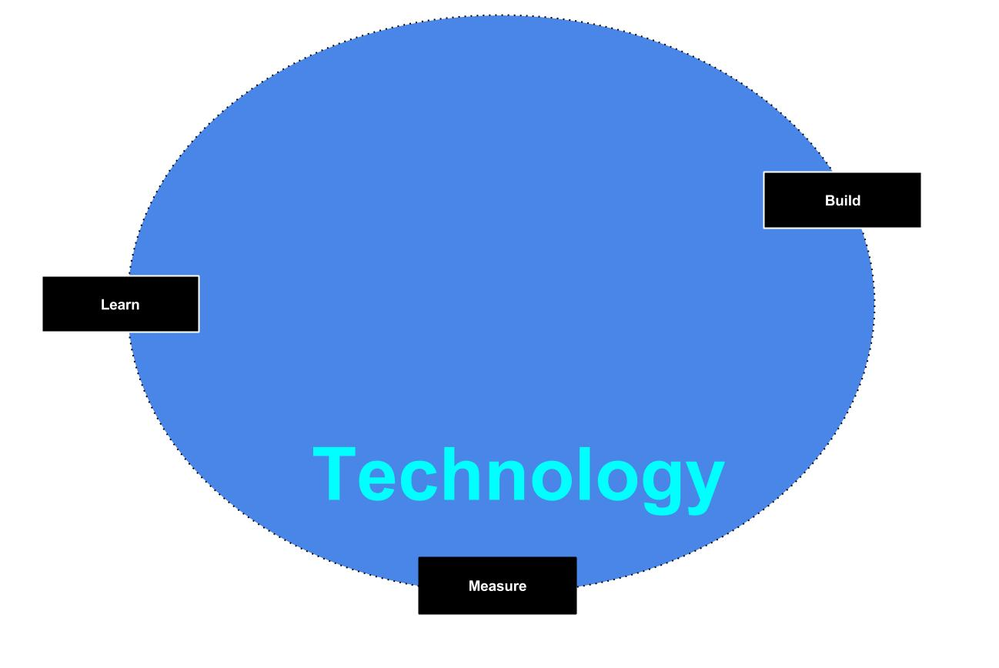
Technology
Requirements
Practical Value
Availability
Usability
Visual
Scalability
javascript
jquery
Mean
WebGL
three.js
Unity
AR

Slide 10
Technology
Use Case
Leading Technical Solutions
Asset Tool
Education
Creative Workflow
Productivity
Technical Documentation
javascript
jquery
Meen
WebGL
three.js
Unity
AR
Security
(Build 1.0- Classified)

Slide 11
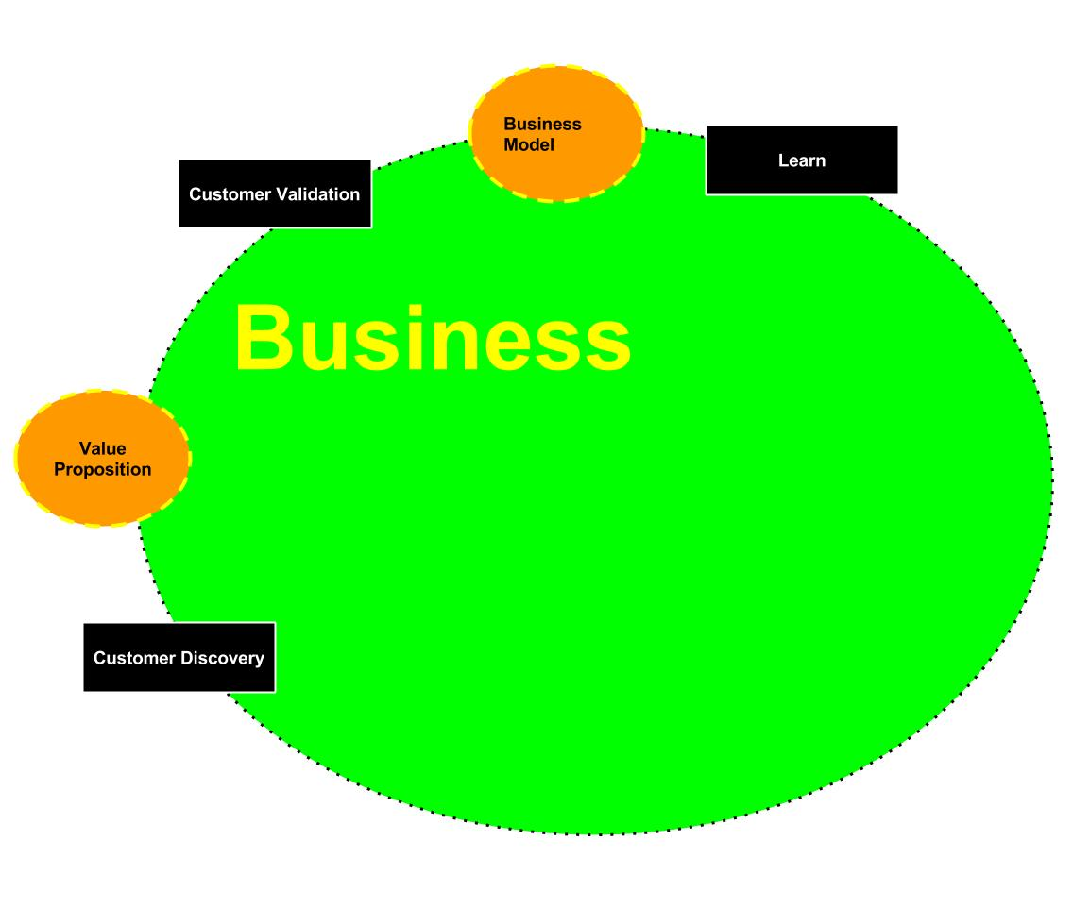
Business
Requirements
Gain Practical Skills
Gain Certs
Gain Masters & MBA
Gain 150 Save in the bank from Employment and Sales
Gain Patients and intellectual Property
Gain A Business Portfolio

Slide 12
Business
1- System - Matrix OS used for Design, Education and Business Productivity
Milestones
0. Create Partnerships to raise 1m using PoC’s/Technical Documents/Demos/Crowdfunding/Youtube
Launch a working Linux Distro with all working Features
Customize apps and Configure Images for each workstation
Provision VMs (virtual machines) That can run Windows and Mac environments for needed Commercial Applications
Create Server environments
Create Secure Network
Host Infrastructure IN THE CLOUD
Create web Apps Around CLoud Services
100- Apps using my framework- networked together with tools to operate Effectively and Efficiently
Milestone
Grow to middle size business
Hire Skilled Employees to grow Departments and verticals USING THE Cultural requirements
Launch Marketplace And Console
10- Vertical Based Sites Changing the way the world interacts with information & Technology
Milestones
10k
Start Game Development
100k
Start Mobile Development
500k
Start Tablet Development
1m
Start Suite Development

Slide 13
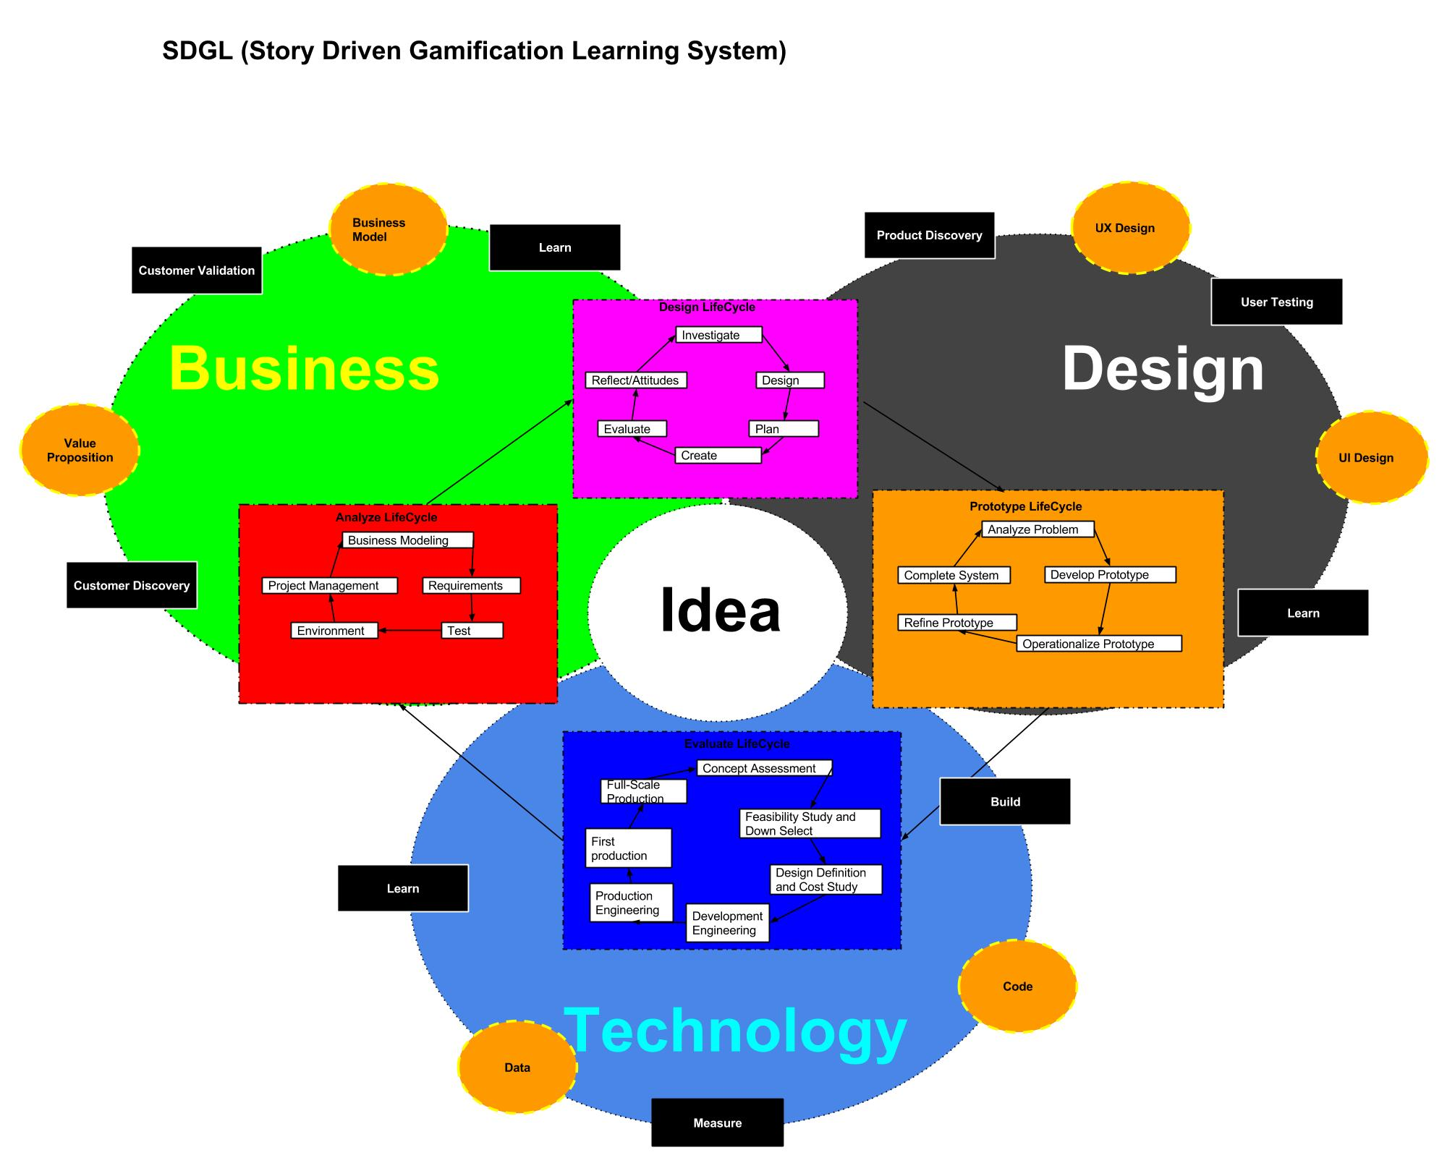
MGS Development System

Slide 14
Business Case
One of the lowest moments of my live was a 6 year span where I was lost in the world of warcraft. I'm a member of millions around the world that play video games and learn no useful skill with all the time and effort put into the game and achievements. Image load screens as free time that can be used to learn the level buy decoding the secret story behind the design of the level or the dungeon. imagine seeing the mapps and the post of great artwork and projects from other elite games. the best solutions are ranked and liked gain popularity and fame. more importantly the best assets must be….an idea a dreamer can like to read (because it's practical and useful), seeked and recorded by a Mage....designed into form by a creator, and most importantly achieve with the power of the voice and fuel with the will of the heart buy the lover’s song.
Wonder is not an endeavor that is ventured alone. Help Save the Land of Wonder in the first game from Black Fox studios: “Wonderland”
Business Case
Problem statement
Mission or vision statement
Specific objectives
preferred approach
Expected benefits
Performance and progress measures
Risk and ways to address them
Plan of work, timeline, and key milestones
Project management and staffing
Cost estimates and funding sources
Alternatives considered
Opposing arguments and responses
Reference

Slide 15
Business Objectives
Here is a System i hope to someday turn into a system to document the world's information so that it can be easily shared and understood by all! (i will have a template for each element in 90 days)
We will mask the development in Games built in AR for the Hololens and other tech
CREATE A gAMING STUDIO for open source storytelling
We will build a Tech lab configured for learning techbase products. Focused on research, Design, Development, Prototyping, Crowdfunding, Marketing and Sales REMOTELY. ALL individuals have the right to improve their skills and innovate By only using their will and doing the hard work over time.
Coursework that explains each step of the learning process and each topic of learning using a cloud based LMS!
The US needs an open source Learning System! using your computer and a new OS, you will have a process to learn all free information on the web using Project based learning.
Business Objective
Business Problem
Business Objectives
Product Concept
Success Metrics
Reference

Slide 16
Game Studio Scope & Requirements
Achievements are only earned when you teach and lead others
Achievements must be Shared
Achievements Get you gear Drops from dungeons and the right to lead
Games will Be Fun, Give you a Epic Feeling and let you Experience unforgettable moments in the game.
You Learn By achieving In the game you play to have fun.
Learning is Masked behind the Characters in the game. Who give you quest that push the story AND Teach you a practical skill
Course work will be Provide around the Capture 9 Course and posted in the intranet system in game (like in skyforge MMO)
All personal Intranet Pages are Social Media Enabled and all Achievements MUST be Shared!
Gaming System Requirements
Gaming System Requirements
Story
Script
Storyboard
(Moral)Parable
Theme
Story Genre
Roles
Class and characters
Boss and Master
Leader and Mentor
Rule
If Evil wins they must tell the good guys their plan (Show work with Proof)
Have Resource to do it on your own
work as a team!
Practice champions get to be boss (Indepent tools? project)
Leaders are ONLY Defined by the ability to score high and explain (effectively) the process to his/her team
Objective
Mission Briefing by Master or Mentor
Development
Class
Lesson Plan
Test
Practice sets
Study Guide
Outline
Practice Utility Kit
Implement
Play
Stage(modules)
Game
Execute in public
Record
Video Content
Autio Content
Documentation
Broadcast
Promote
Analize
Produce

Slide 17
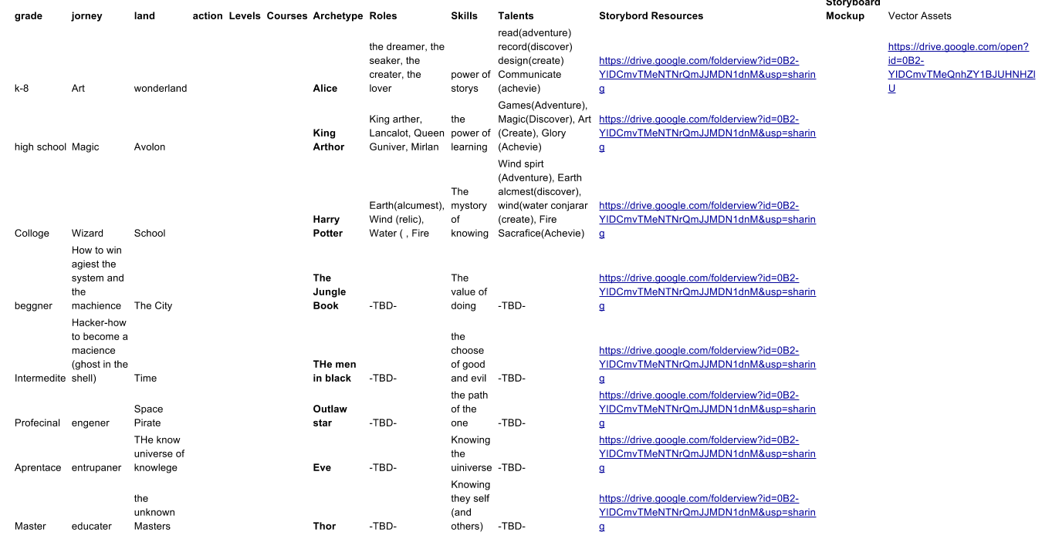
Game Studio Production Plan
Game Release Order
Wonderland- K -8
Avalon - High School
Merlen School -College
The City Of Zion - Entry level Professional
The Men In Black -intermediate level
Star Outlaw-Professional
New Eve -Apprentice
Old Gods -Master

Slide 18
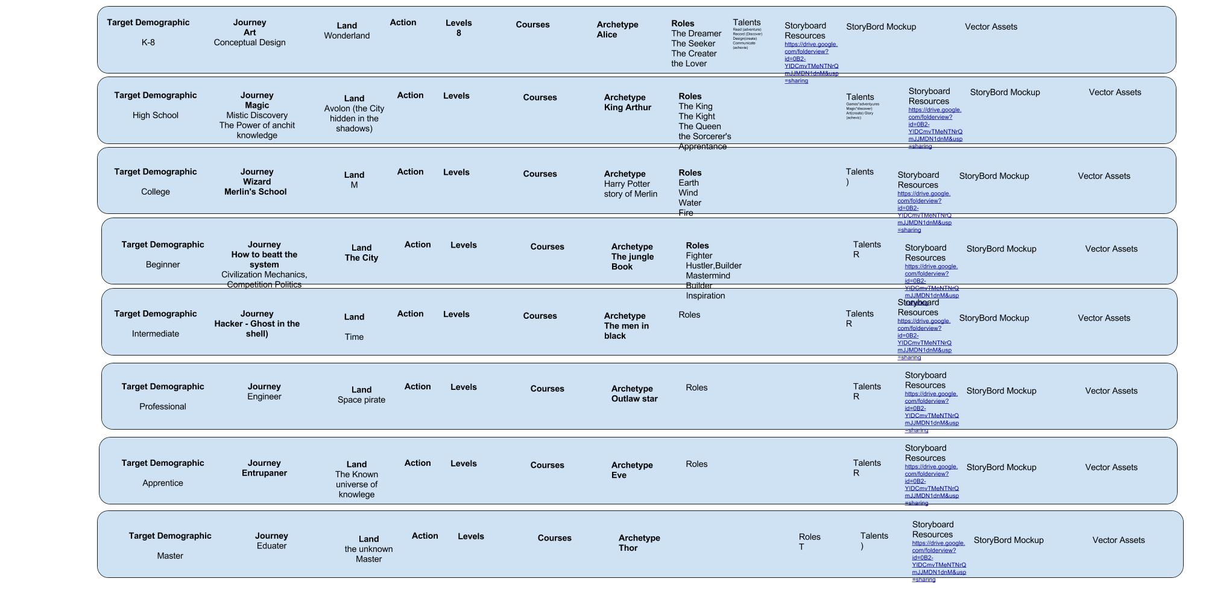
The Game Plan

Slide 19
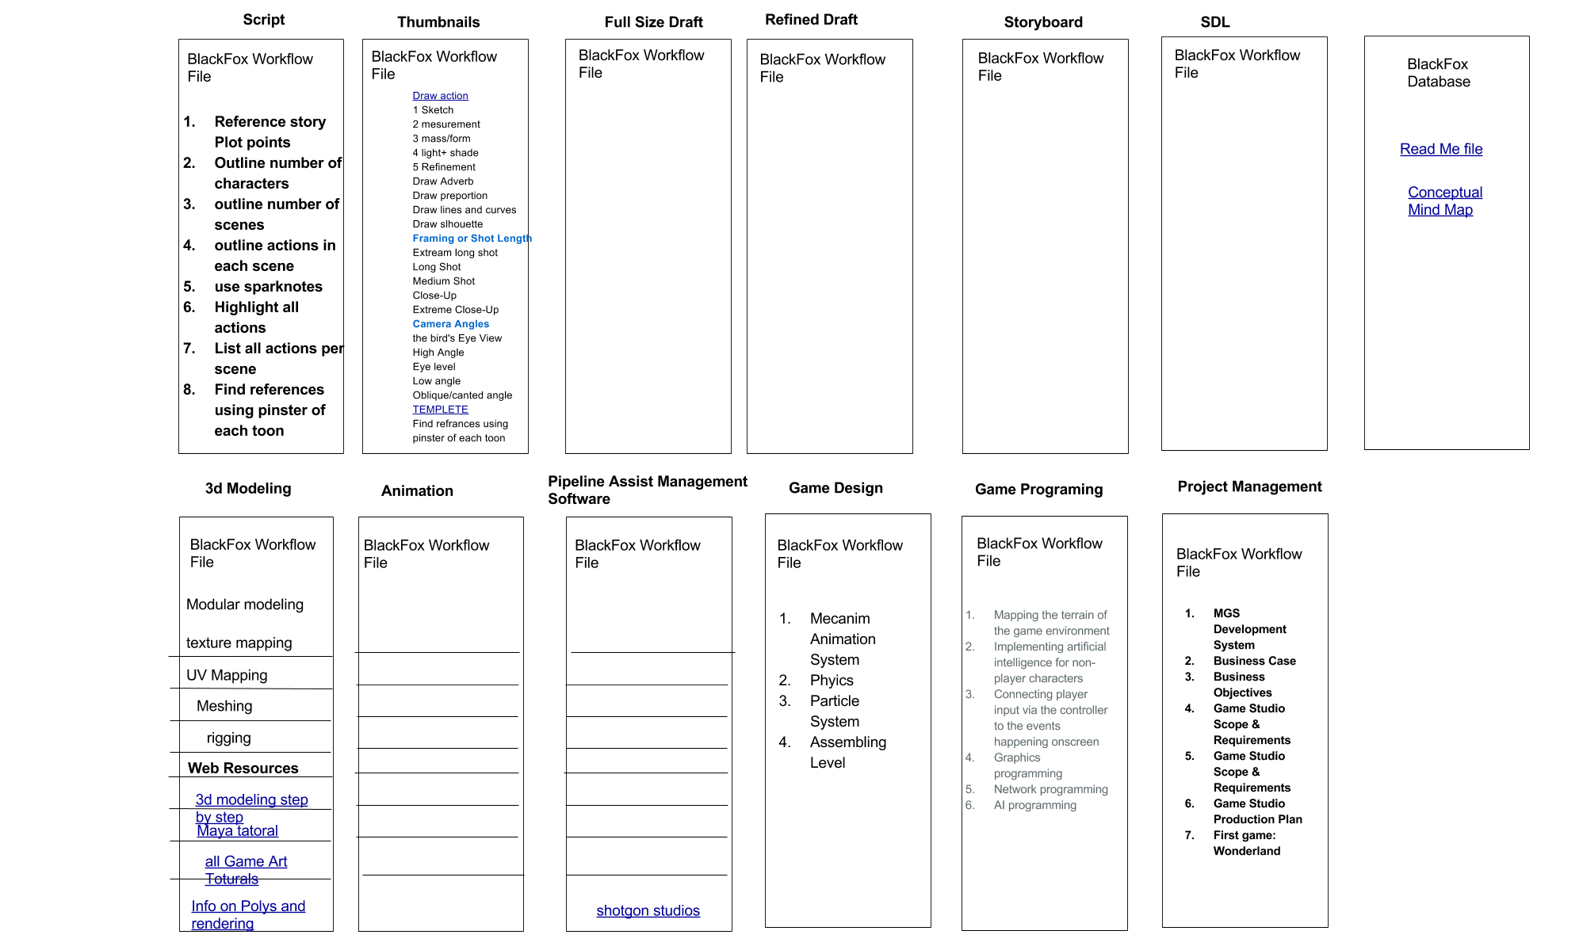
Project Plan

Slide 20
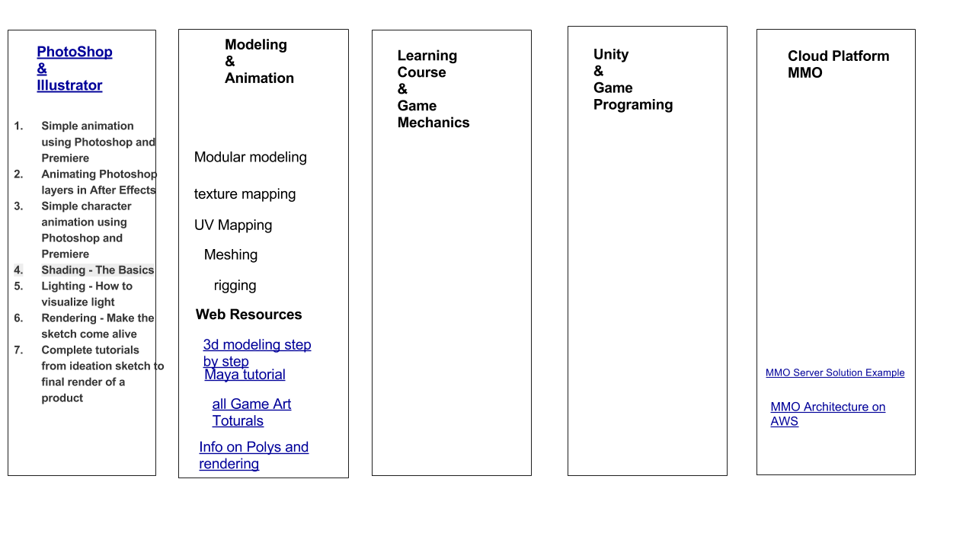
BackFox Corporate training

Slide 21
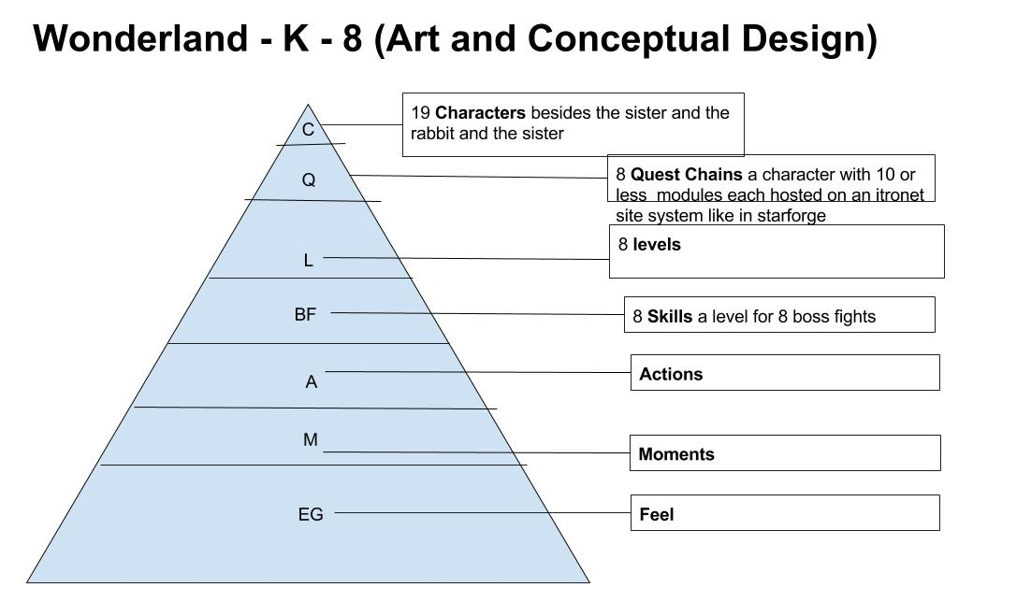
First game: Wonderland
The universe is built on stories. this land of wonder is built on ideas.
Game Mechanic
You learn to create a new toon as a character. now you can create a piece of armor like you can your toon. your armor is a living character.
The Story of your aromr is the story of a work of art.. its design is your joruoirny…. have fun...learn how to be great… let nothing ever block your imagination.

Slide 22
First game: Wonderland
Actions example 1 | The Mask of Design
overview
you have been invited to a masked ball.
the mad hatter is unveiling his new wonderful idea.
Quest Chain 1
You must build your mask for the party
you must learn the process to design a mask.
you must gain the skill by practicing the crafting process and being guided to websites by NPC’s
Your profile will be placed on a board and your Techniques will be Sharing and gain Likes

Slide 23
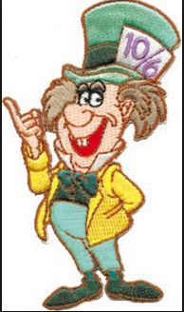
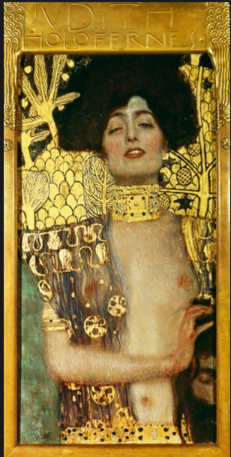
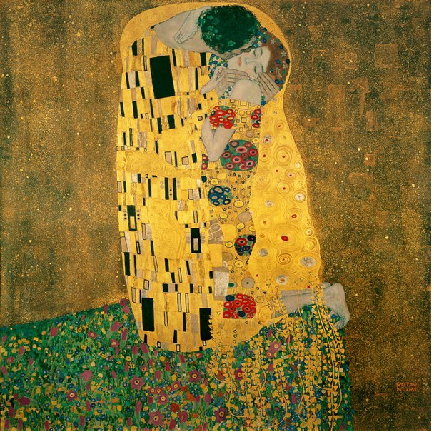
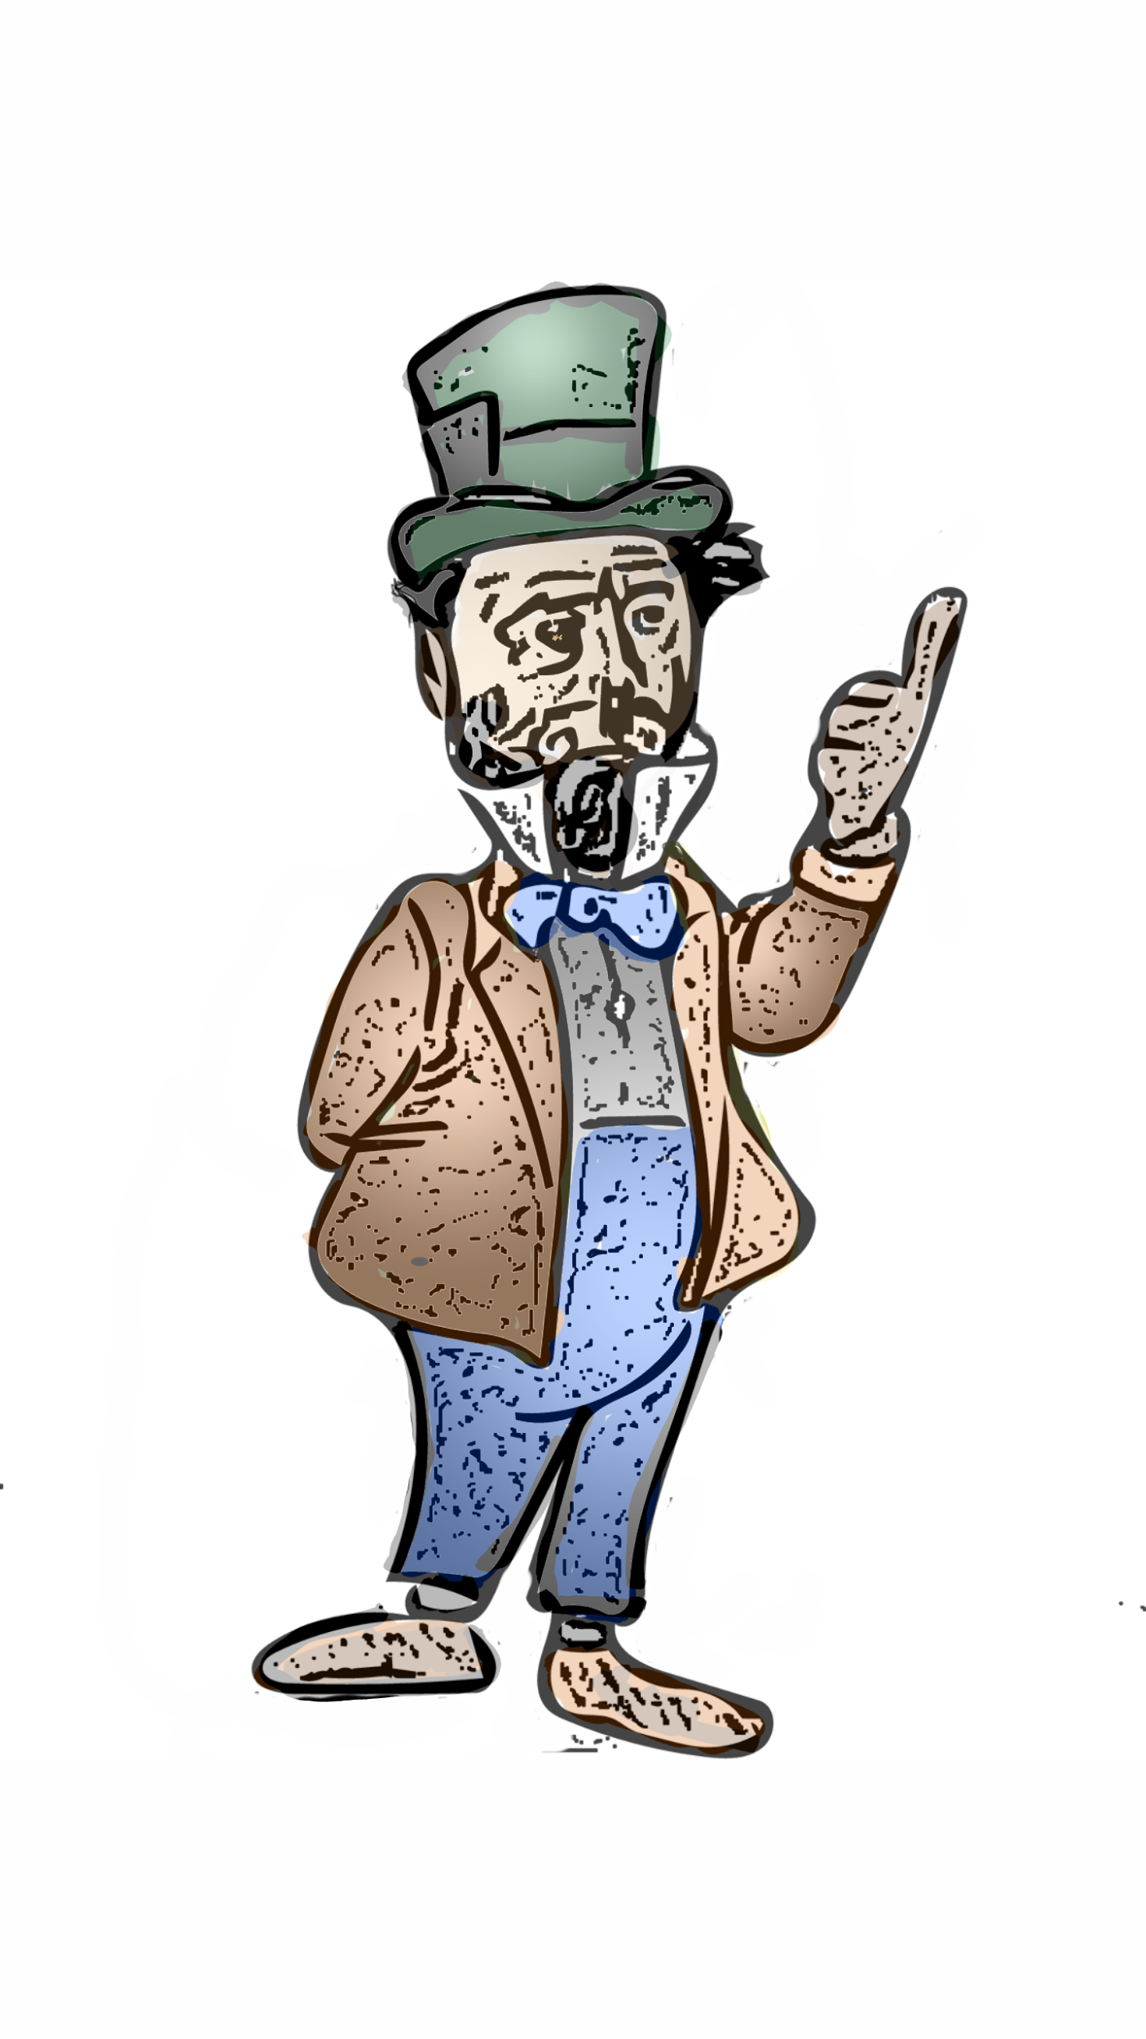
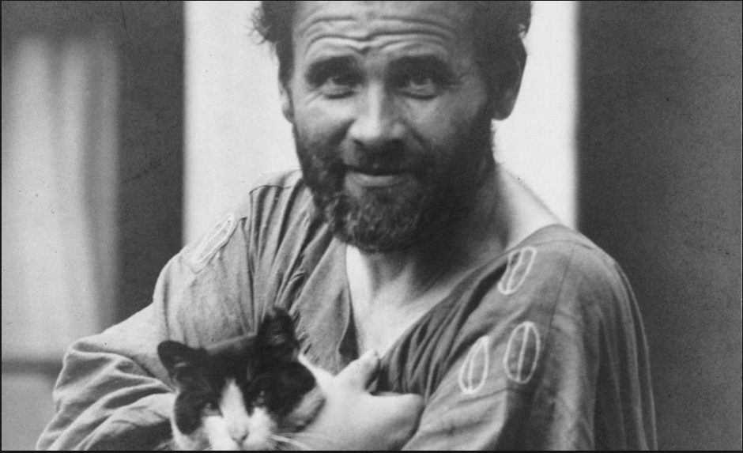
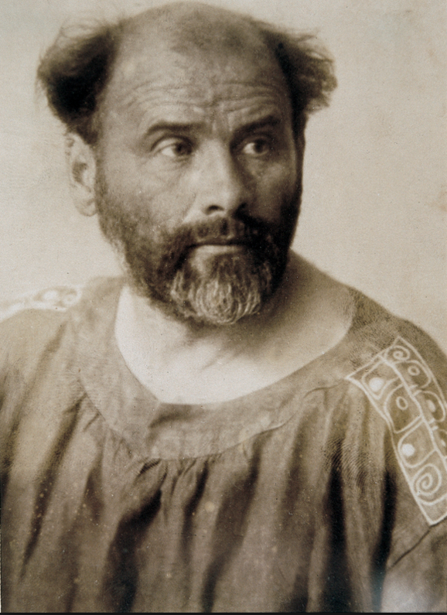
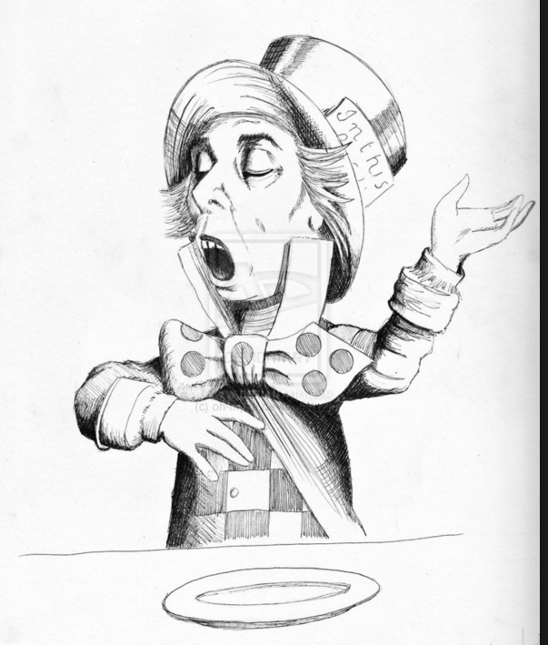
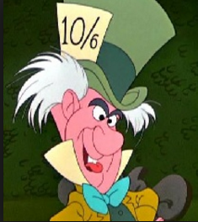
First game: Wonderland
First Character
The Mad Hatter

Slide 24
First game: Wonderland
Actions example 2 | Cat Net
overview
Same as the mask but this time the cat wishes to speak to the user..breaking the fourth wall. to do this the cat wants to create a way to market wonderland idea to the user. he will obviously use the internet. because the internet love cats! each complete assignment will post and add value to cat content on the internet. this content will be presented in a way to increase seo marketing and view views for all gaming studio content.
you must build a website to advertise one of your ideas to all users from wonderland.
Quest Chain 1
You must build your website for the cat's idea of breaking the 4th wall and talking with the user...
you must learn the process to design a mask.
you must gain the skill by practicing the crafting process and being guided to websites by NPC’s
Your profile will be placed on a board and your Techniques will be Sharing and gain Likes

Slide 25
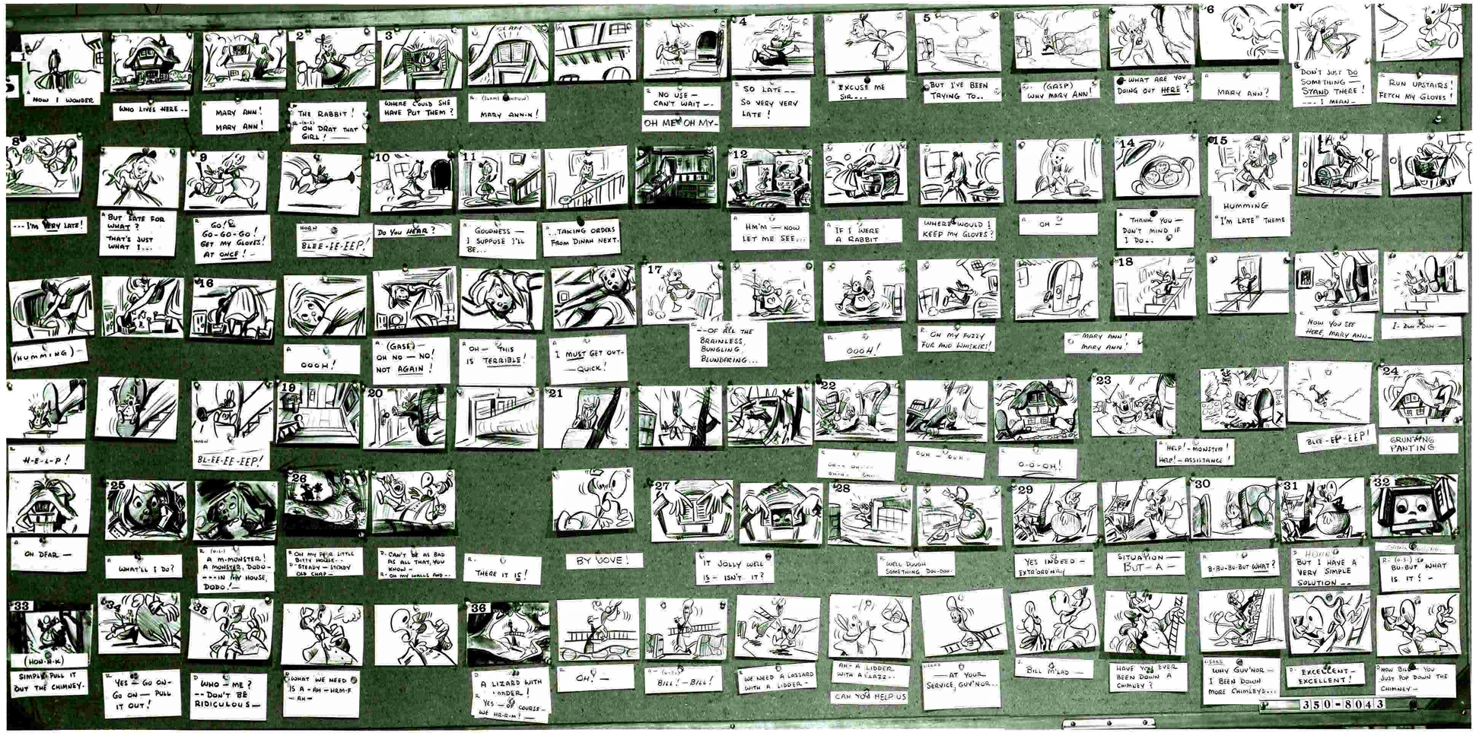
Storyboard

Slide 26
Level 1
Alice sits on a riverbank on a warm summer day, drowsily reading over her sister’s shoulder, when she catches sight of a White Rabbit in a waistcoat running by her. The White Rabbit pulls out a pocket watch, exclaims that he is late, and pops down a rabbit hole. Alice follows the White Rabbit down the hole and comes upon a great hallway lined with doors. She finds a small door that she opens using a key she discovers on a nearby table. Through the door, she sees a beautiful garden, and Alice begins to cry when she realizes she cannot fit through the door. She finds a bottle marked “DRINK ME” and downs the contents. She shrinks down to the right size to enter the door but cannot enter since she has left the key on the tabletop above her head. Alice discovers a cake marked “EAT ME” which causes her to grow to an inordinately large height. Still unable to enter the garden, Alice begins to cry again, and her giant tears form a pool at her feet. As she cries, Alice shrinks and falls into the pool of tears. The pool of tears becomes a sea, and as she treads water she meets a Mouse. The Mouse accompanies Alice to shore, where a number of animals stand gathered on a bank. After a “Caucus Race,” Alice scares the animals away with tales of her cat, Dinah, and finds herself alone again.

Slide 27
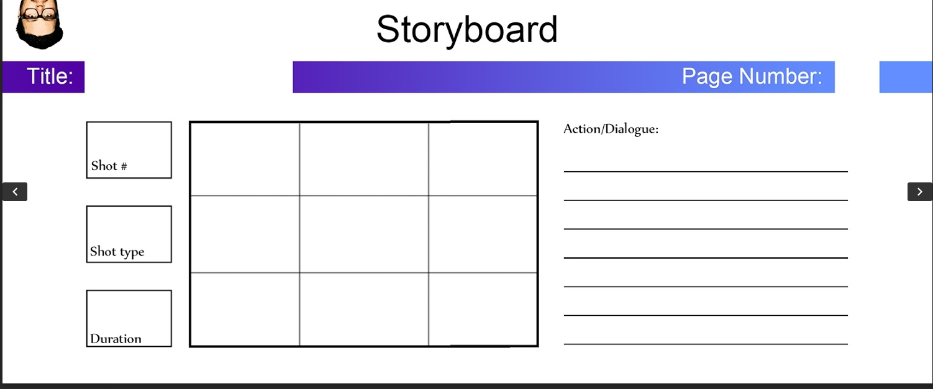
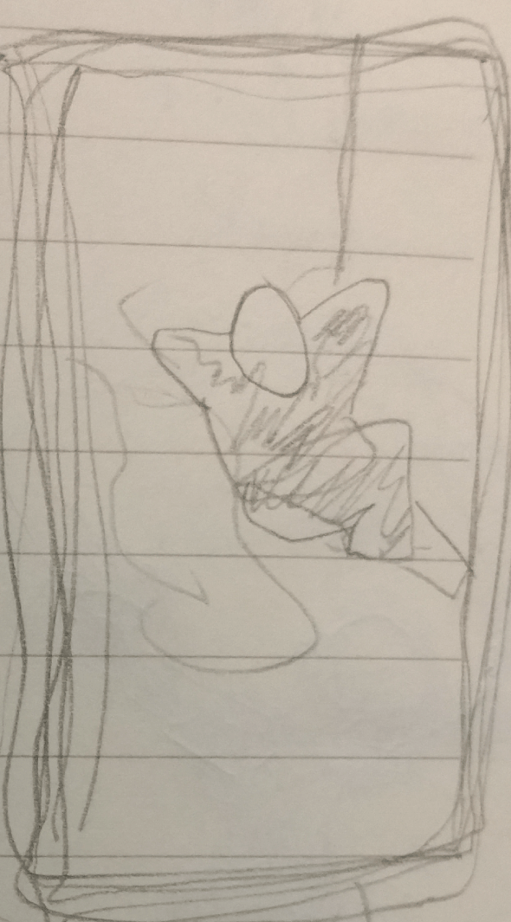
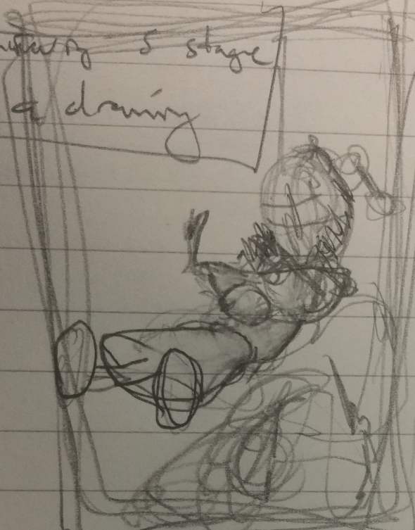
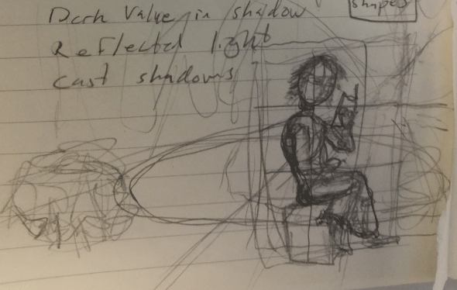

Slide 28
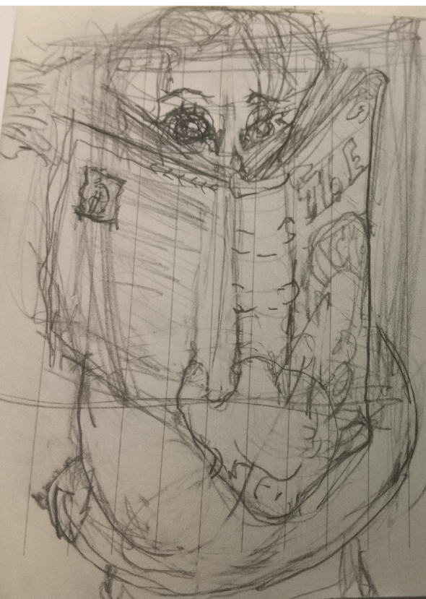
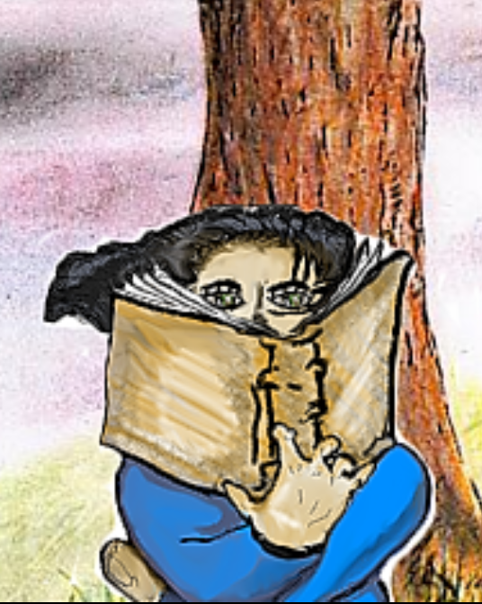
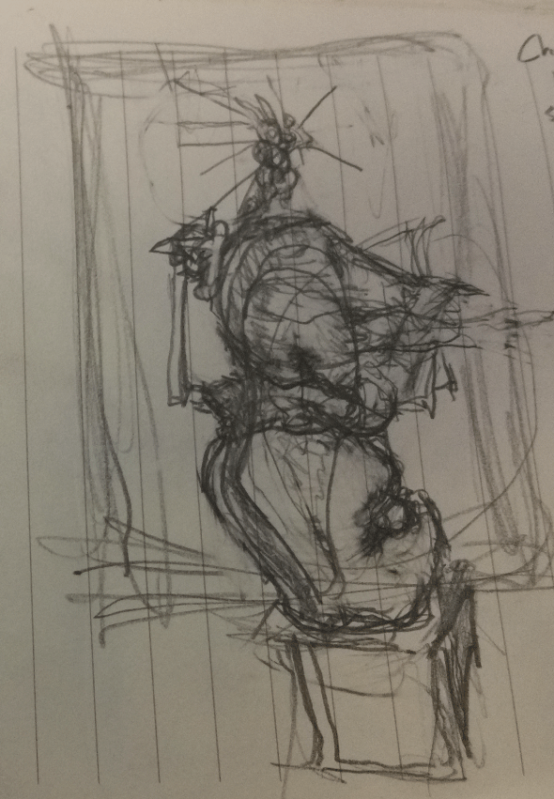
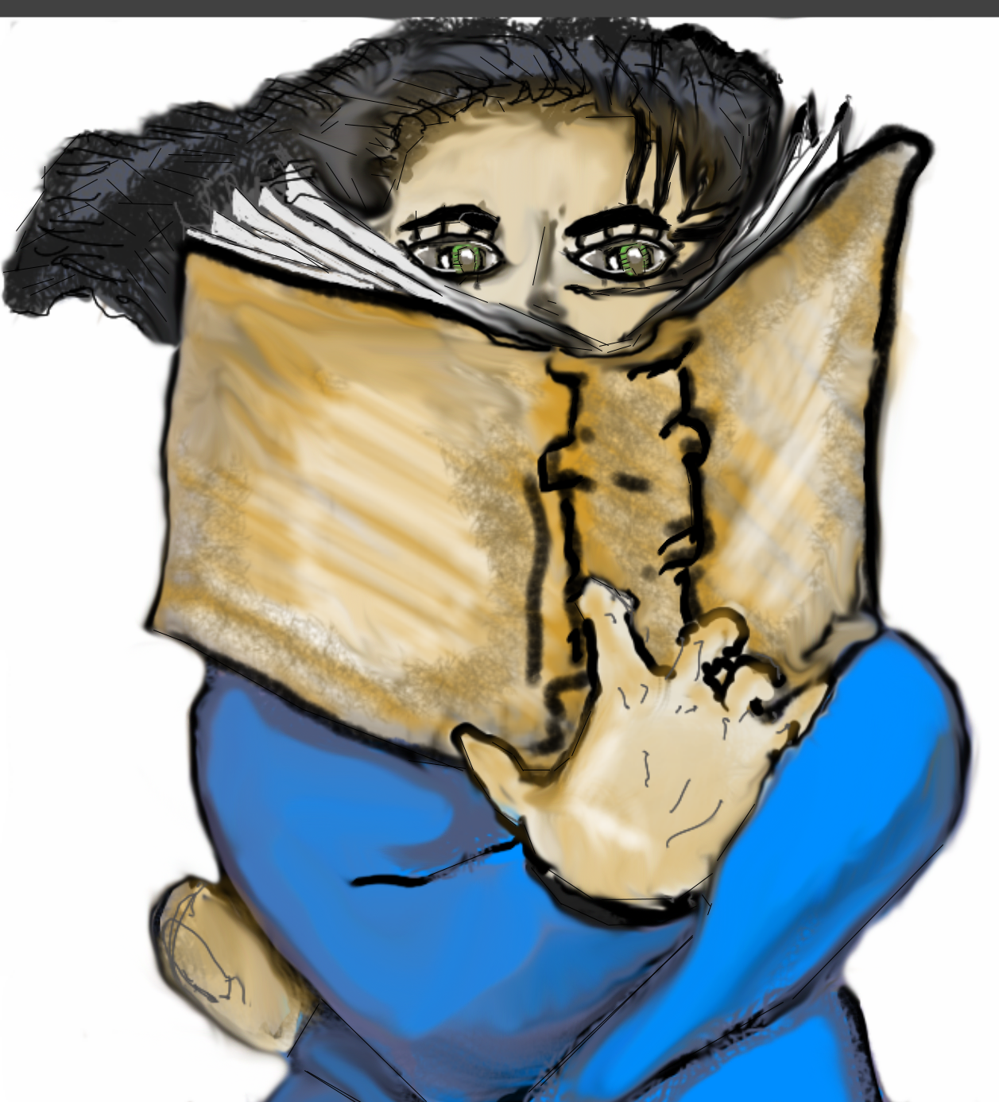
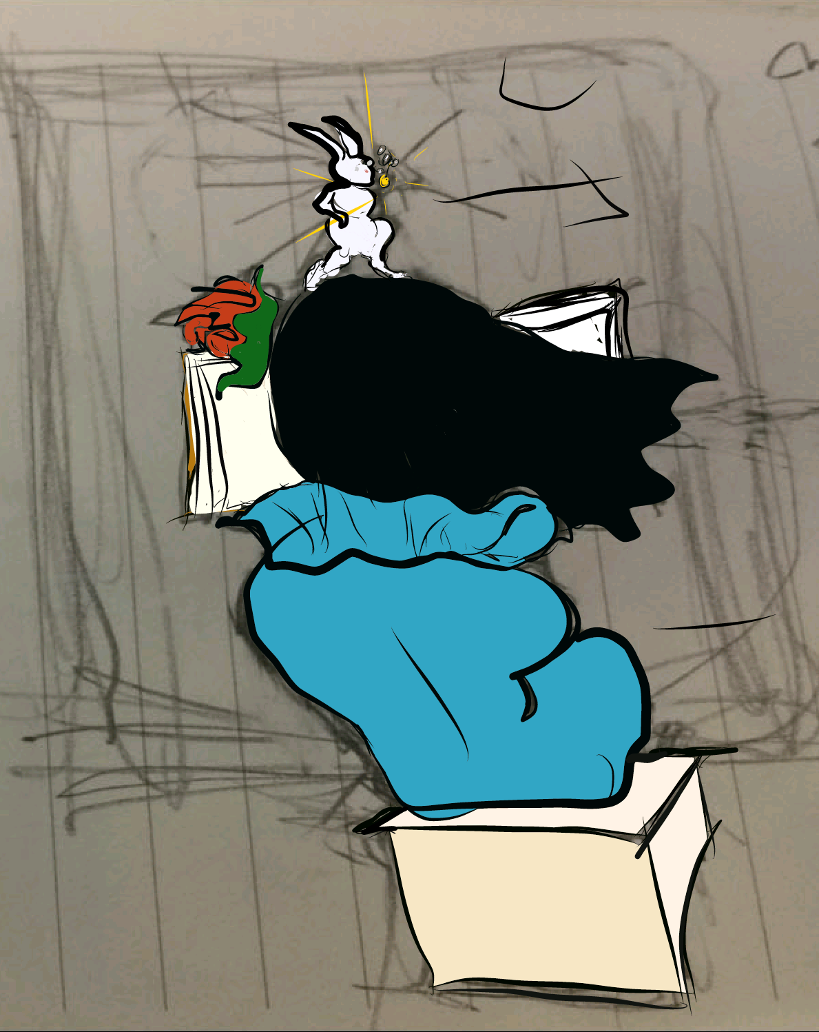

Slide 29
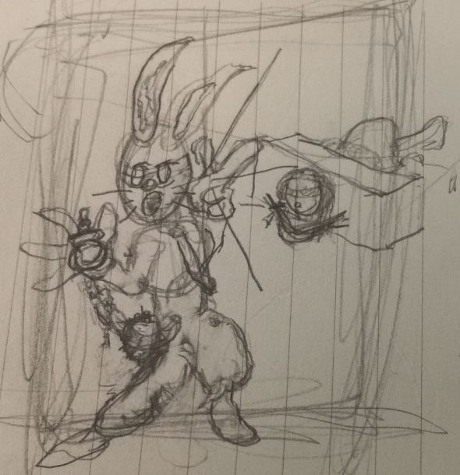
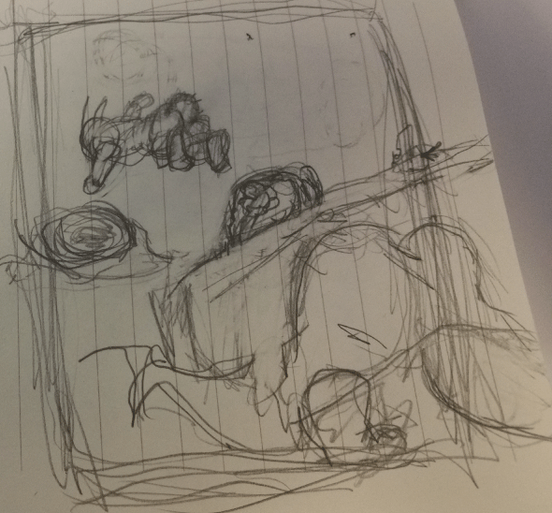

Slide 30
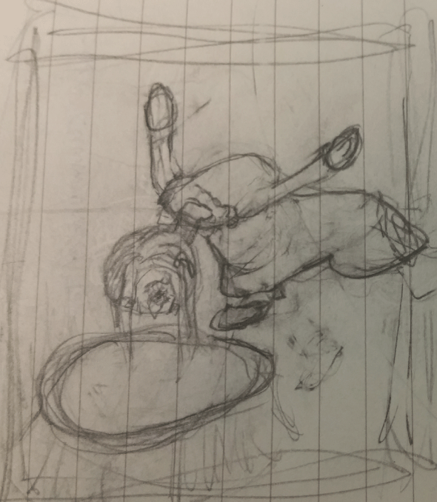
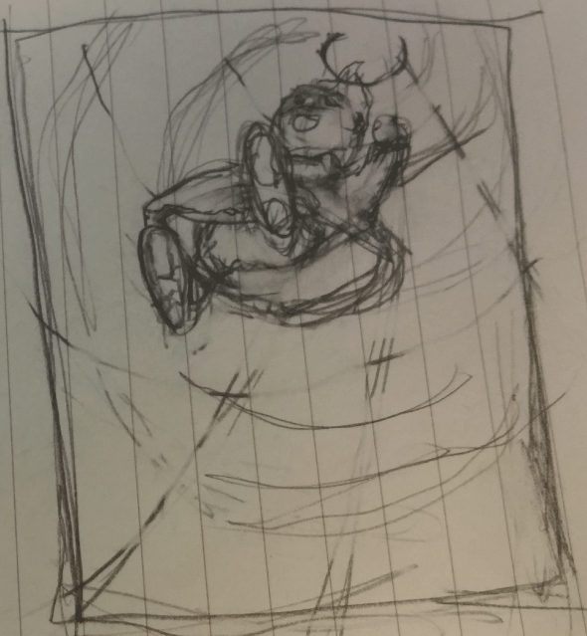

Slide 31
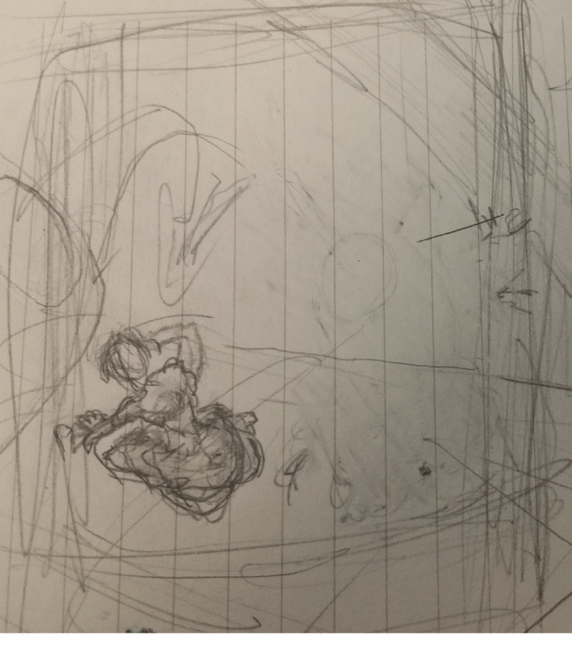
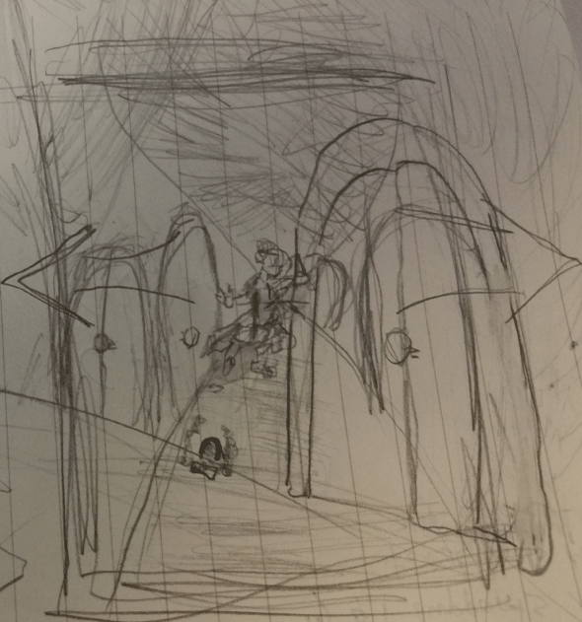

Slide 32
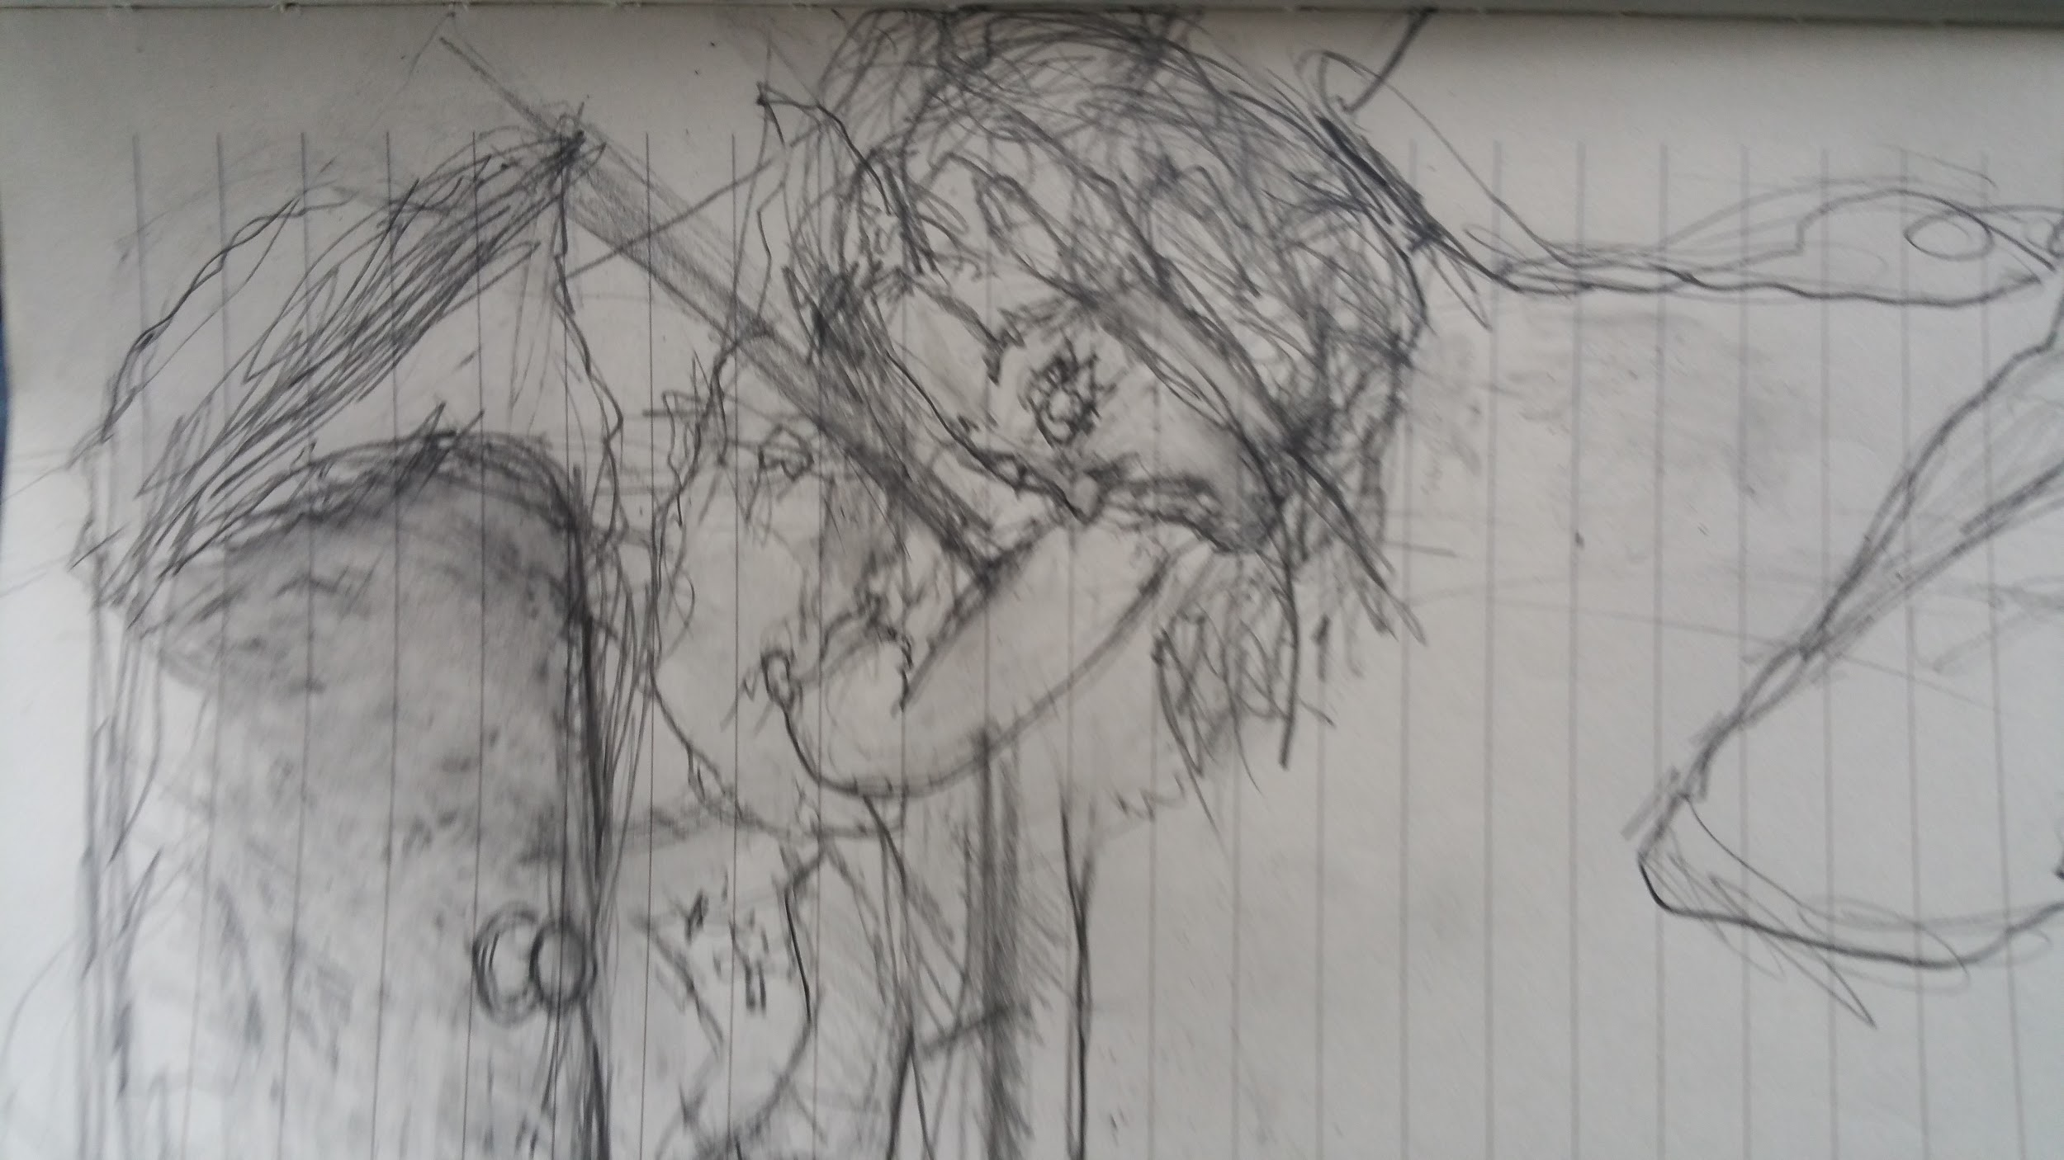

Slide 33
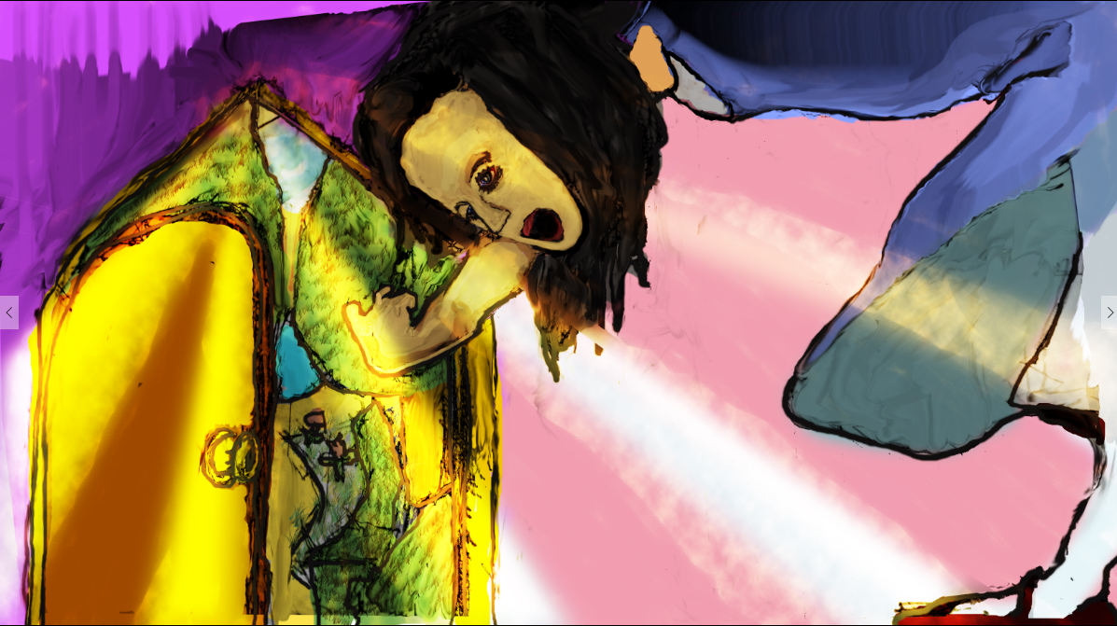

Slide 34
Level 2
Alice meets the White Rabbit again, who mistakes her for a servant and sends her off to fetch his things. While in the White Rabbit’s house, Alice drinks an unmarked bottle of liquid and grows to the size of the room. The White Rabbit returns to his house, fuming at the now-giant Alice, but she swats him and his servants away with her giant hand. The animals outside try to get her out of the house by throwing rocks at her, which inexplicably transform into cakes when they land in the house. Alice eats one of the cakes, which causes her to shrink to a small size. She wanders off into the forest, where she meets a Caterpillar sitting on a mushroom and smoking a hookah (i.e., a water pipe). The Caterpillar and Alice get into an argument, but before the Caterpillar crawls away in disgust, he tells Alice that different parts of the mushroom will make her grow or shrink. Alice tastes a part of the mushroom, and her neck stretches above the trees. A pigeon sees her and attacks, deeming her a serpent hungry for pigeon eggs.

Slide 35
Level 3
Alice eats another part of the mushroom and shrinks down to a normal height. She wanders until she comes across the house of the Duchess. She enters and finds the Duchess, who is nursing a squealing baby, as well as a grinning Cheshire Cat, and a Cook who tosses massive amounts of pepper into a cauldron of soup. The Duchess behaves rudely to Alice and then departs to prepare for a croquet game with the Queen. As she leaves, the Duchess hands Alice the baby, which Alice discovers is a pig. Alice lets the pig go and reenters the forest, where she meets the Cheshire Cat again. The Cheshire Cat explains to Alice that everyone in Wonderland is mad, including Alice herself. The Cheshire Cat gives directions to the March Hare’s house and fades away to nothing but a floating grin.

Slide 36
Level 4
Alice travels to the March Hare’s house to find the March Hare, the Mad Hatter, and the Dormouse having tea together. Treated rudely by all three, Alice stands by the tea party, uninvited. She learns that they have wronged Time and are trapped in perpetual tea-time. After a final discourtesy, Alice leaves and journeys through the forest. She finds a tree with a door in its side, and travels through it to find herself back in the great hall. She takes the key and uses the mushroom to shrink down and enter the garden.

Slide 37
Level 5
After saving several gardeners from the temper of the Queen of Hearts, Alice joins the Queen in a strange game of croquet. The croquet ground is hilly, the mallets and balls are live flamingos and hedgehogs, and the Queen tears about, frantically calling for the other player’s executions. Amidst this madness, Alice bumps into the Cheshire Cat again, who asks her how she is doing. The King of Hearts interrupts their conversation and attempts to bully the Cheshire Cat, who impudently dismisses the King. The King takes offense and arranges for the Cheshire Cat’s execution, but since the Cheshire Cat is now only a head floating in midair, no one can agree on how to behead it.

Slide 38
Level 6
The Duchess approaches Alice and attempts to befriend her, but the Duchess makes Alice feel uneasy. The Queen of Hearts chases the Duchess off and tells Alice that she must visit the Mock Turtle to hear his story. The Queen of Hearts sends Alice with the Gryphon as her escort to meet the Mock Turtle. Alice shares her strange experiences with the Mock Turtle and the Gryphon, who listen sympathetically and comment on the strangeness of her adventures. After listening to the Mock Turtle’s story, they hear an announcement that a trial is about to begin, and the Gryphon brings Alice back to the croquet ground.

Slide 39
Level 7
The Knave of Hearts stands trial for stealing the Queen’s tarts. The King of Hearts leads the proceedings, and various witnesses approach the stand to give evidence. The Mad Hatter and the Cook both give their testimony, but none of it makes any sense. The White Rabbit, acting as a herald, calls Alice to the witness stand. The King goes nowhere with his line of questioning, but takes encouragement when the White Rabbit provides new evidence in the form of a letter written by the Knave. The letter turns out to be a poem, which the King interprets as an admission of guilt on the part of the Knave. Alice believes the note to be nonsense and protests the King’s interpretation. The Queen becomes furious with Alice and orders her beheading, but Alice grows to a huge size and knocks over the Queen’s army of playing cards.

Slide 40
Level 8
All of a sudden, Alice finds herself awake on her sister’s lap, back at the riverbank. She tells her sister about her dream and goes inside for tea as her sister ponders Alice’s adventures.

